Slide 1



MyHealthGuide
Team names

Slide 2

Introduction
Many people struggle to find nearby clinics and hospitals when they are ill or in an emergency. Sometimes they don’t know what services are offered, the opening hours, or how to get there. This delay could lead to serious health risks. | We are building this solution for everyday people-students, parents, the elderly, and anyone who needs fast access to health care. They need a tool that is easy to use, gives clear information, and works quickly when time matters most. | Our app, MyHealthGuide, helps people find the nearest health facilities, shows what services are available, provides emergency contacts, and gives directions. It turns a big problem into a simple solution that can help save time, reduce stress, and even save lives.

Slide 3

The Problems MyHealthGuide solves
People often waste time looking for nearby clinics, hospitals, or pharmacies, especially in emergencies. They also struggle to know what services are offered or if a facility is open.
We are solving this for everyday users-students, parents, elderly people and anyone in need of quick health support. These users want fast, clear information without having to browse multiple sources.
We designed an app that locates nearby health facilities, shows their services, emergency contacts, and directions-all in one place. This solution saves time and supports better health decisions.

Slide 4

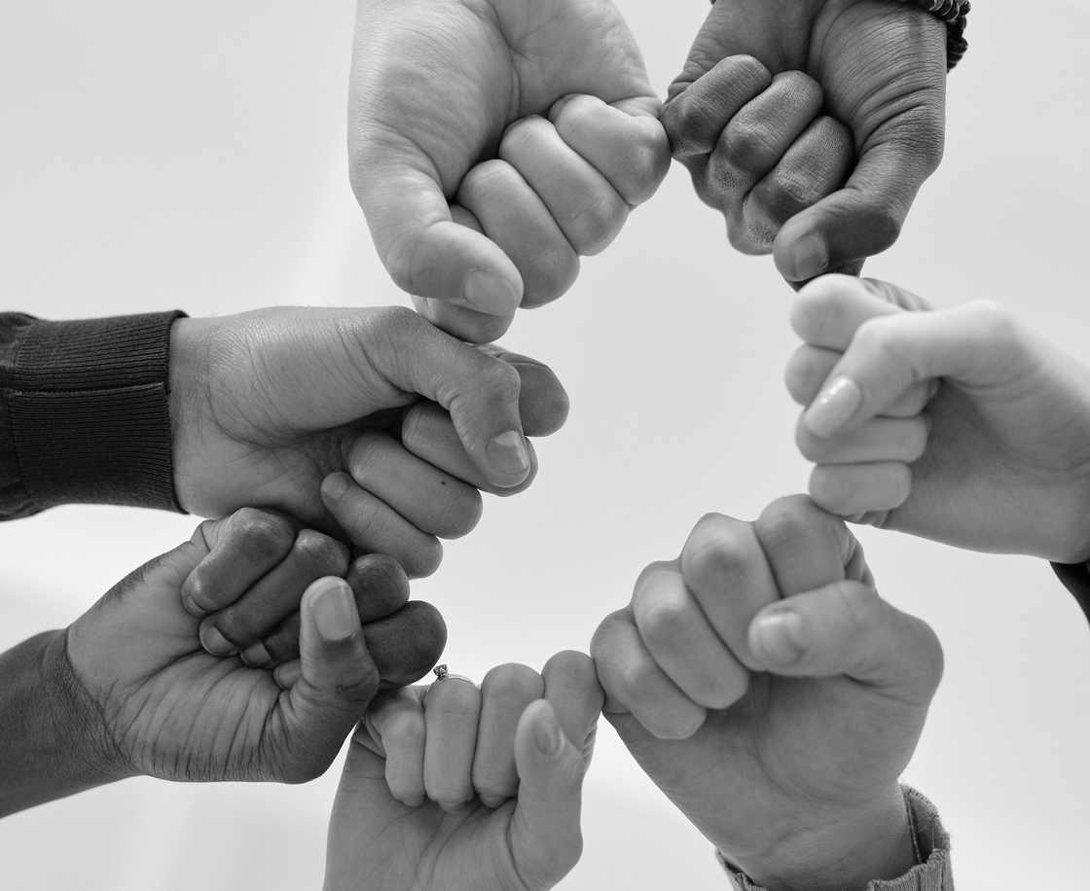

Offered Solutions
03.
02.
Growth Potential
The app can expand to include appointment booking, multi-language support, and integrations with national support systems-making it scalable and useful across different countries.
01.
Innovation
MyHealthGuide brings together location tracking, emergency info, and service listings in one simple app
Collaborative team
Built a passionate team combining coding, design, and user research to make health access smarter.

Slide 5



Next Steps
We had trouble finding reliable health centre information, but we solved it by using trusted sources and organising the data clearly in the app.
Presenter Challenges

Slide 6
Thank You.

